Slide 1
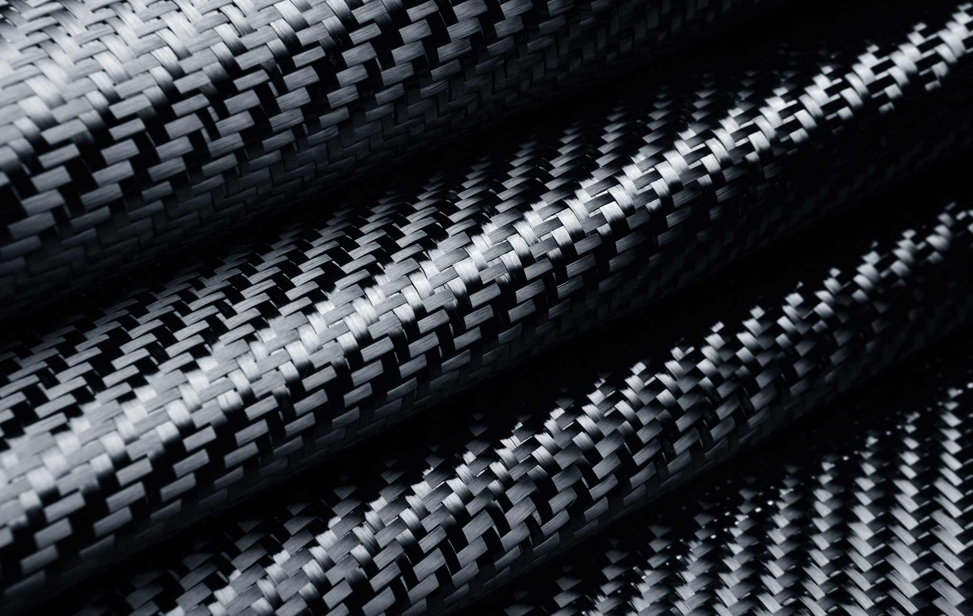
Composite Materials:
Truncated Cone Structure
Diego Mataix Caballero

Slide 2
Index
1. Design requirements.
2. Material properties.
3. Design choices and CAD model.
4. FEM model.
4.1 Meshing.
4.2 Material and laminates.
4.3 Loads and boundary conditions (BCs).
4.4 Optimization.
5. Results.
4.1 Linear Static.
4.2 Buckling.
5. Conclusions and future work.

Slide 3
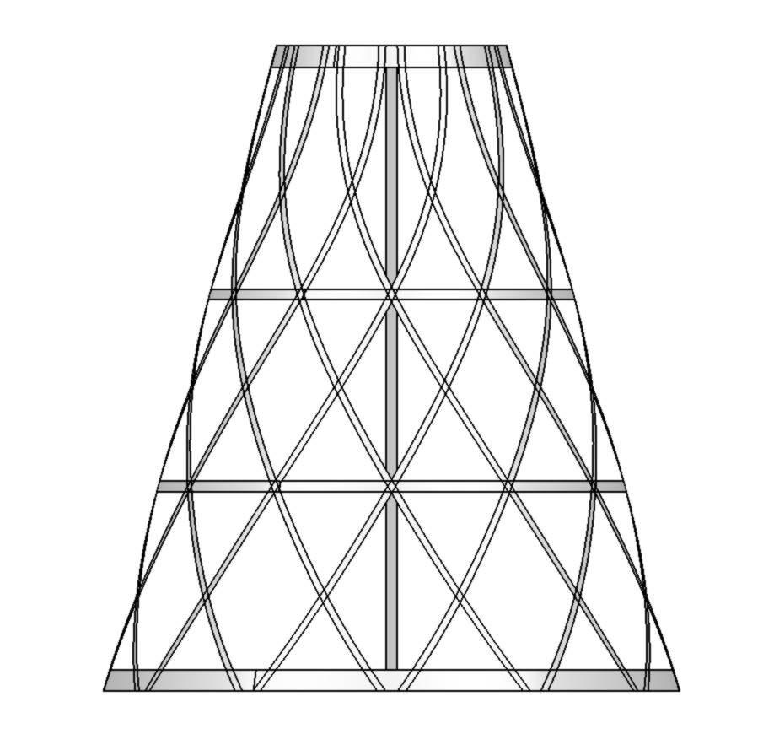
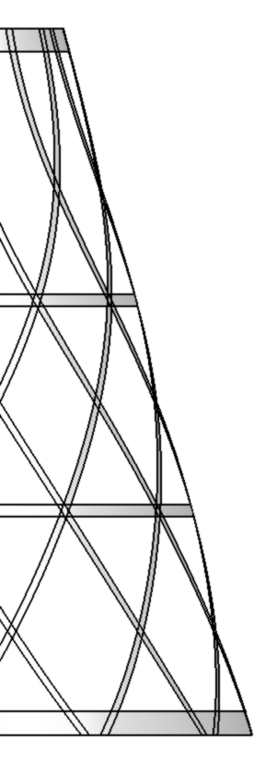

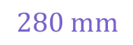

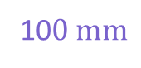

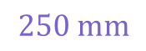
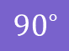
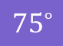
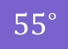

Design Requirements Material properties Design choices and CAD model FEM model Results Conclusions
Introduction: Design Requirements
Lattice truncated cone structure
Geometrical Requirements
Loads and Boundary Conditions
10$0 mm$
15 kN
$${90}^{∘}$$
Width:
Helicoidal stiffeners $=3 mm$
$$280 mm$$
Vertical stiffeners $=5 mm$
Horizontal stiffeners $=5 mm$
$${75}^{∘}$$
$${55}^{∘}$$
$$250 mm$$
Supported
Maximum allowed displacement $=2 mm$

Slide 4

Material Properties
2D Orthotropic

Slide 5
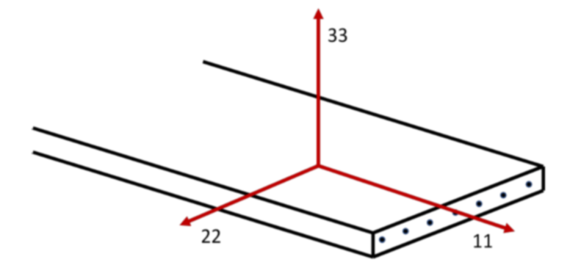
Design Requirements Material properties Design choices and CAD model FEM model Results Conclusions
Material properties
Process:
Use the available dataset and fit the distribution with the best fit (log likelihood) between: Normal, LogNormal, Weibull.
Note! Use values at room temperature dry (RTD) and normalized with material thickness
2. Determine the following values:
Modulus → Mean value
Strengths → Base value
Fibre dominated properties → Normalized
Matrix dominated properties → Non-normalized
Linear Elastic
Failure – Stress – Hill
 | Stiffeners (traction) | Stiffeners (compression)
Elastic Modulus 11 [GPa] | 158.489 | 140.932
Elastic Modulus 22 [GPa] | 8.949 | 9.712
Poisson Ratio 12 | 0.316 | 0.356
Shear Modulus 12 [GPa] | 4.649 | 4.649
Shear Modulus 23 [GPa] | 4.649 | 4.649
Shear Modulus 13 [GPa] | 4.649 | 4.649
Density [g/mcc] | 1.58
 | Stiffeners (traction) | Stiffeners (compression)
Tension Stress Limit 11 [GPa] | 2.233 | 2.233
Tension Stress Limit 22 [GPa] | 0.051 | 0.051
Compress Stress Limit 11 [GPa] | 1.418 | 1.418
Compress Stress Limit 22 [GPa] | 0.255 | 0.255
Shear Stress Limit [GPa] | 0.089 | 0.089
Bonding Shear Stress Limit [GPa] | 0.089 | 0.089

Slide 6


Design choices and CAD model

Slide 7
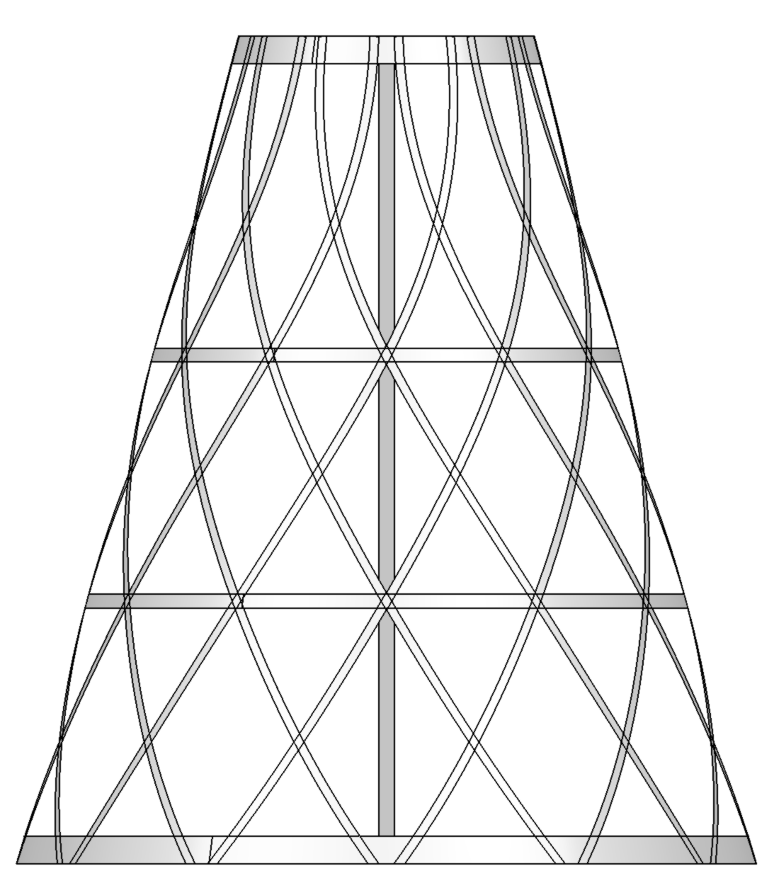
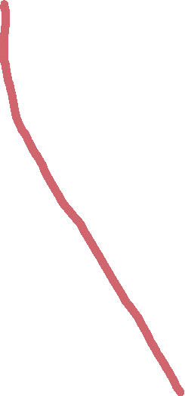
Design Requirements Material properties Design choices and CAD model FEM model Results Conclusions
Design choices and CAD model
Geometry
12 sets of vertical and helicoidal stiffeners
2 sets of intermediate horizontal stiffeners
Top and bottom rings with double width
CAD
Designed to export surfaces only
Only 1 section of the structure was exported, then it would be rotated taking advantage of symmetry

Slide 8
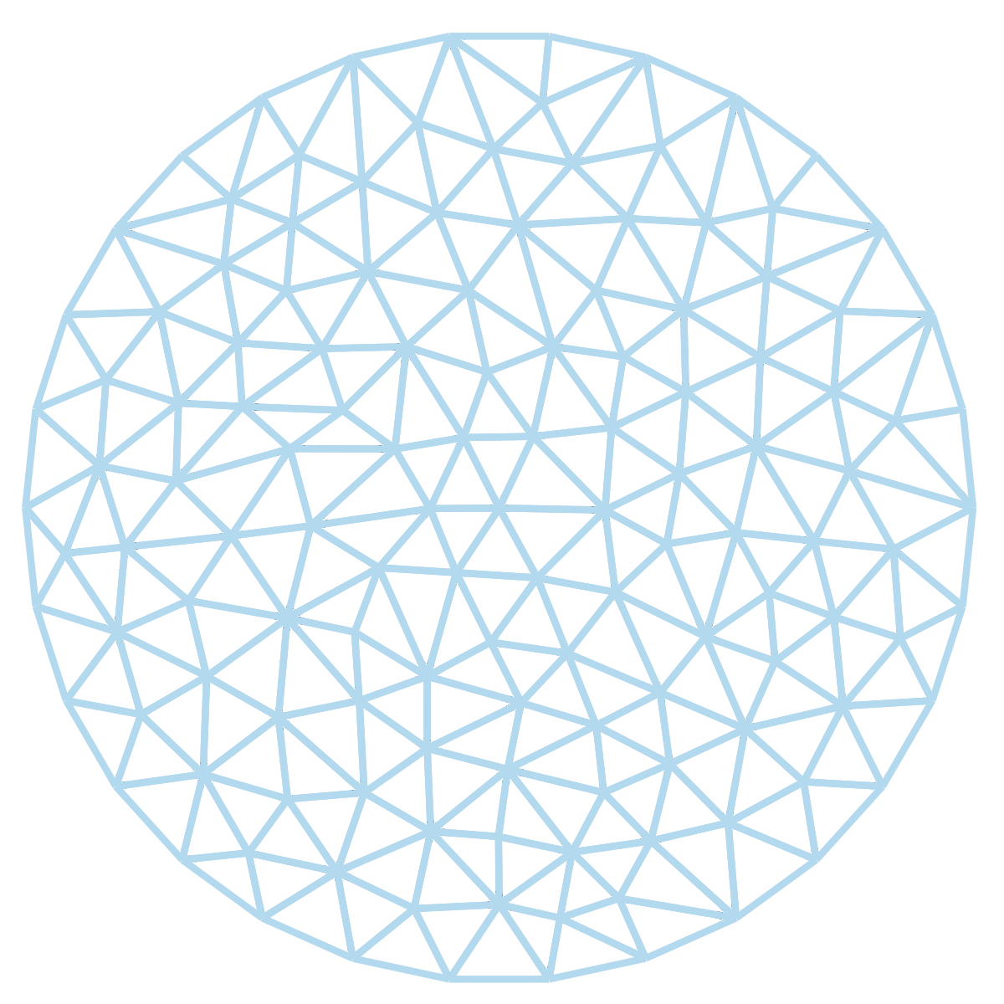
Finite Element Model

Slide 9
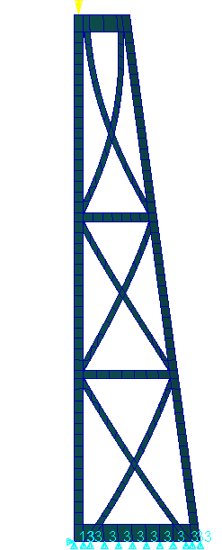
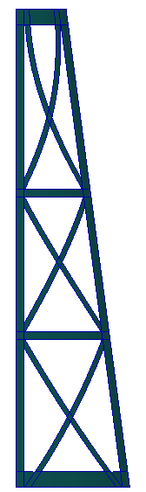
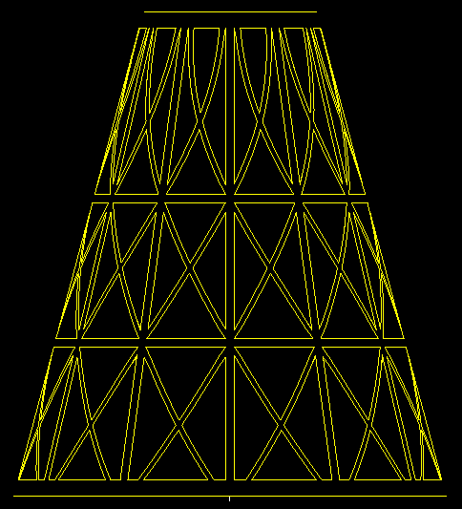











Design Requirements Material properties Design choices and CAD model FEM model Results Conclusions
FEM: Meshing
Surfaces
Break surfaces into separate sections:
Surfaces for stiffeners
Surfaces for intersections between stiffeners
Meshing
CQUAD4 elements where possible:
Isomesh and Hybrid
Tria elements otherwise
Node equivalence

Slide 10
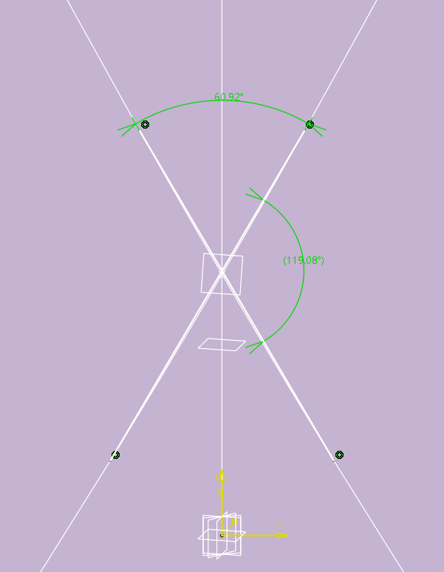
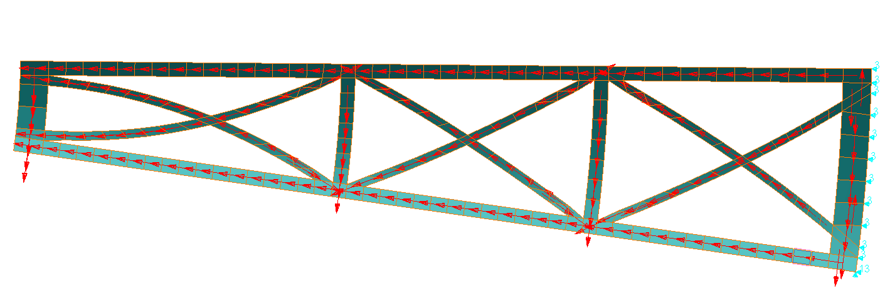
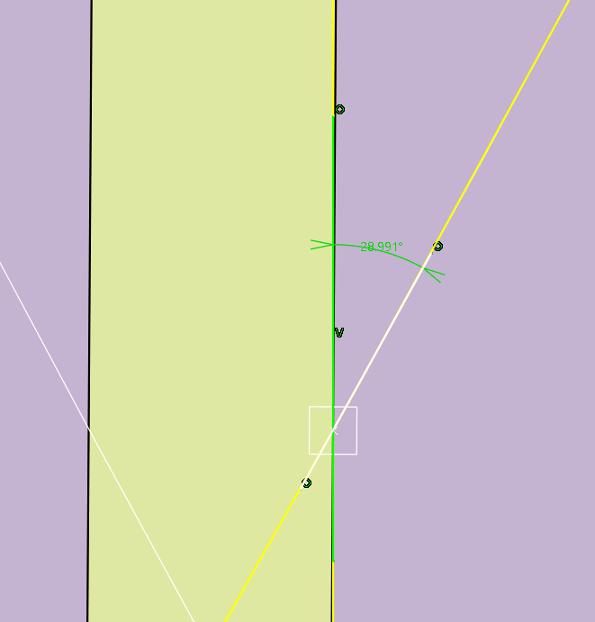
Design Requirements Material properties Design choices and CAD model FEM model Results Conclusions
FEM: Materials and Laminates
Material Orientation
Measure Angles
Laminate Groups
Create:
Groups
Laminate materials
Shell properties
Legend:
Compression (C)
Traction (T)
C_0: Helicoidal + vertical stiff.
T_0: Horizontal stiff.
CC_33.3: Helicoidal stiff. cross
CC_57.5: Helicoidal stiff. cross
CC_60.9: Helicoidal stiff. cross
CTC_0-90-24.1: Triple stiff. cross
CTC_0-90-29: Triple stiff. cross
CT_0-55: Helicoidal + horiz. cross
CT_0-90: Helicoidal/vertical + horiz. cross

Slide 11
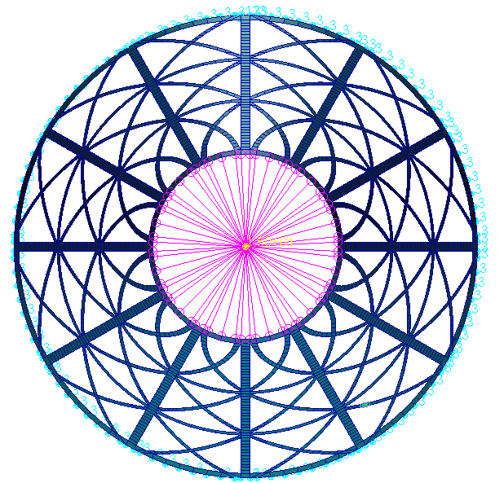




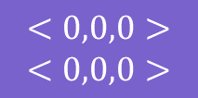



Design Requirements Material properties Design choices and CAD model FEM model Results Conclusions
FEM: Loads and Boundary Conditions (BCs)
$$<0,0,0>$$
RBE2
RBE2 element with all 6 DOFs as dependant terms.
Load applied to the MPC node connected to the RBE2 elements
$$<0,0,0>$$
$$<0,0,0>$$
BCs
$$15 kN$$
Fixed displacement in $z$ in the bottom
Fixed displacement in $x,y$ in one point
Fixed displacement in $x$ in the opposite point
$$y$$
BCs
$15 kN$ in the $z−$ direction
$$x$$
$$<0,,0>$$

Slide 12

Design Requirements Material properties Design choices and CAD model FEM model Results Conclusions
FEM: Optimization
The 1st iteration had 10 laminate layers for each stiffener in the model
Top ring: 4 laminate layers
Intermediate top ring: 5 laminate layers
Intermediate bottom ring: 6 laminate layers
Bottom ring: 8 laminate layers
Horizontal stiffeners
Vertical stiffeners
10 laminate layers
Helicoidal stiffeners
9 laminate layers
Mass $=148.7 g$

Slide 13



Results

Slide 14
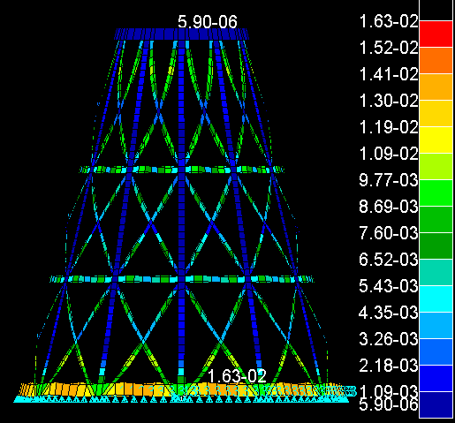
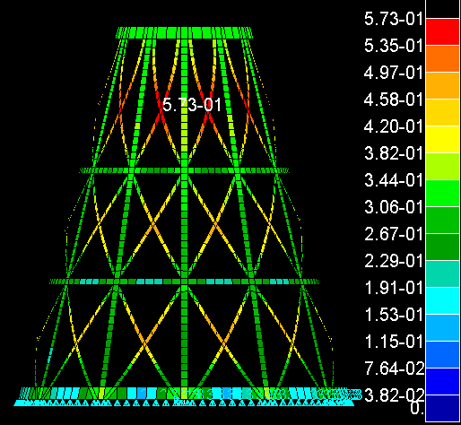
Design Requirements Material properties Design choices and CAD model FEM model Results Conclusions
Results: Linear Static
Displacements, Rotational
Displacements, Translational

Slide 15
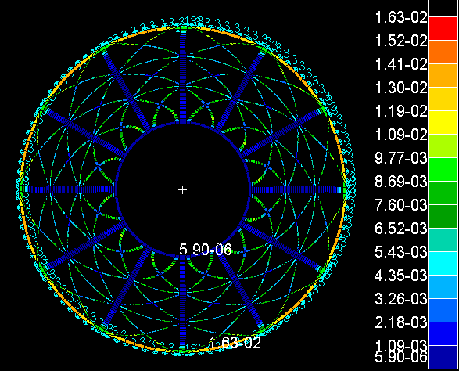
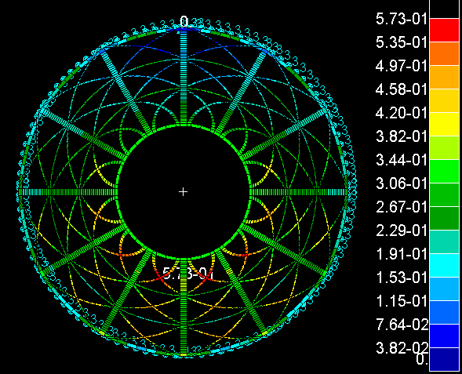
Design Requirements Material properties Design choices and CAD model FEM model Results Conclusions
Results: Linear Static
Displacements, Rotational
Displacements, Translational

Slide 16
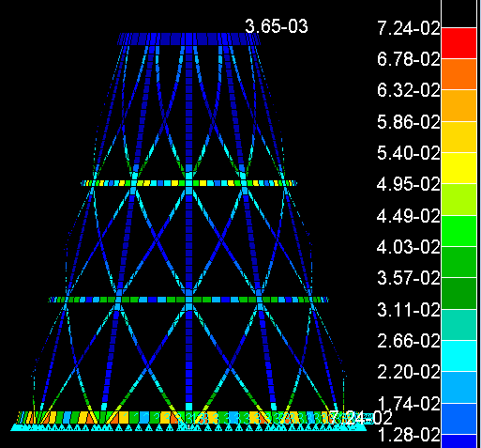
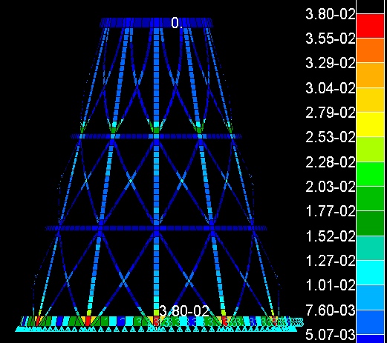
Design Requirements Material properties Design choices and CAD model FEM model Results Conclusions
Results: Linear Static – Failure Indices
→ Failure Indices for the laminate layers that are implemented in the model
Laminate Layer | Bond Indices | Ply Indices
1 | 4.22E-02 | 2.52E-02
9 | 5.05E-02 | 1.72E-02
10 | 4.97E-02 | 1.26E-02
14 | 2.54E-02 | 8.30E-03
18 | 3.80E-02 | 3.80E-02
33 | 1.40E-02 | 2.60E-03
34 | 1.20E-02 | 2.80E-03
Bond Indices
Ply Indices

Slide 17
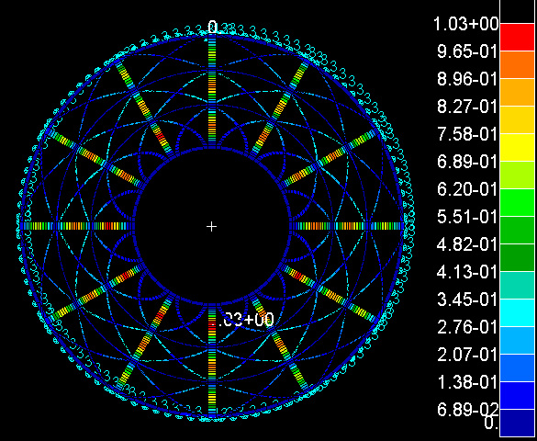
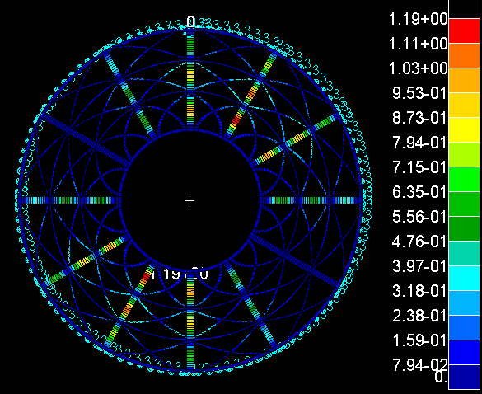
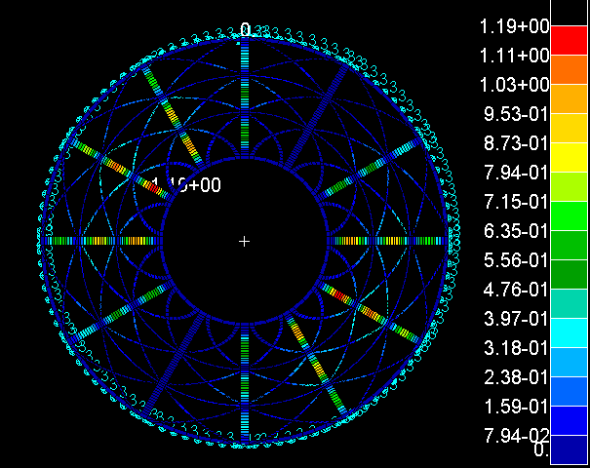
Design Requirements Material properties Design choices and CAD model FEM model Results Conclusions
Results: Buckling
Buckling Critical Load $=17.35 kN$
1st mode - Translational
2nd mode - Translational
3rd mode - Translational
MoS = 15.68 %
MoS = 17.37 %
MoS = 17.42 %
Notes:
Poner a la izquierda:
Specs
- Duracion
- tipo de control térmico (active pasivo)
- temperaturas vs operacionales payload
Poner a la derecha:
Instrumentos de control térmico empleados ← en detalle

Slide 18


Conclusions

Slide 19





Design Requirements Material properties Design choices and CAD model FEM model Results Conclusions
Conclusions and future work
Lattice truncated cone structure
Conclusions
Future Work
Mass $=148.7 g$
Required material $=3.31 m$
Optimization options:
Move top horizontal stiffener to prevent deformation on the top of the cone.
Decrease number of laminate layers where possible.
Maximum displacement $=0.57 mm$
Maximum Failure Index $=7.24∙{10}^{−2}$
Buckling Critical Load $=17.35 kN$
MoS = 15.68 %

Slide 20
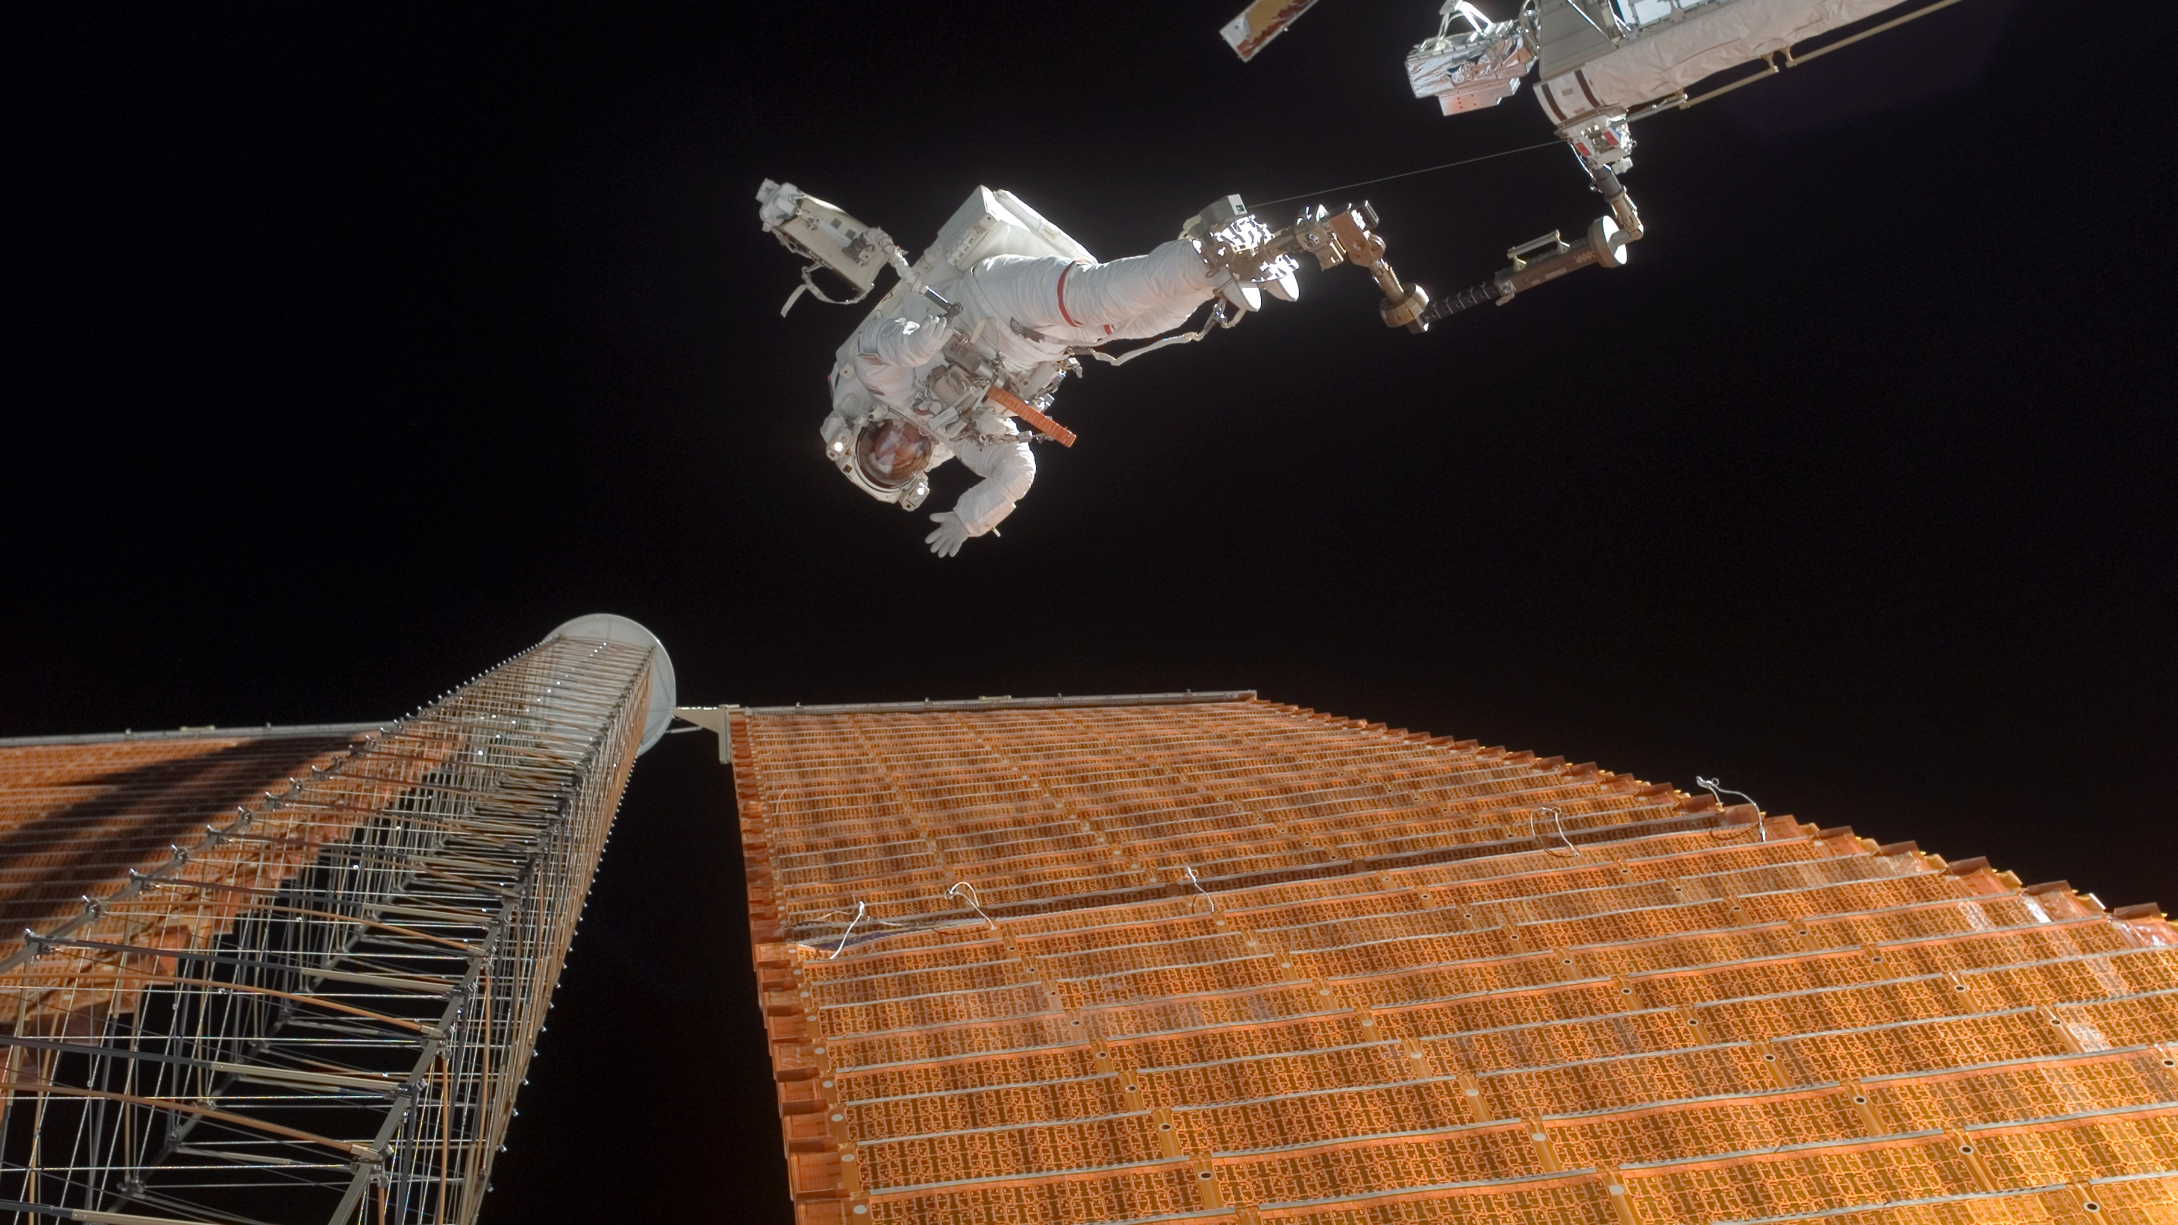
Any questions?

